Slide 1

Boosting Algorithm – XG_Boost_Regression
Presented by Rousan

Slide 2

Delivering with confidence
XG_Boost Regression
XGBoost Regression (Extreme Gradient Boosting Regression) is a highly efficient, scalable, and optimized machine learning algorithm used to predict continuous numerical values (such as house prices, stock values, or temperature). It belongs to the family of ensemble learning algorithms, meaning it combines multiple weaker models to build one highly accurate predictive model

Slide 3
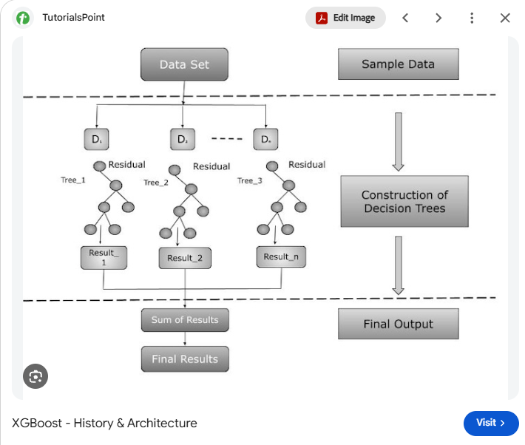

Slide 4
XGBoost Regressor — Key Parameters and Their Purpose
Parameter | Purpose
n_estimators | Sets the number of boosting rounds, usually adding one tree per round.
learning_rate | Controls each new tree’s contribution. Smaller values generally require more trees.
max_depth | Sets the maximum depth of each tree. Deeper trees learn more complex patterns but may overfit.
min_child_weight | Sets the minimum sum of observation Hessians required in a child node. Higher values make splitting more conservative.
subsample | Sets the proportion of training observations sampled for each boosting round.
colsample_bytree | Sets the proportion of features sampled for each tree.
gamma | Sets the minimum loss reduction required to split a node. Higher values discourage additional splits.
reg_alpha | Applies L1 regularization to leaf weights, encouraging some weights to become zero.
reg_lambda | Applies L2 regularization to leaf weights, reducing excessively large weights.
objective | Specifies the training loss. 'reg:squarederror' is commonly used for regression.
tree_method | Specifies how trees are constructed. 'hist' uses histogram-based split calculations.
random_state | Sets the random seed to help make results reproducible.
n_jobs | Sets the number of CPU threads used during training.

Slide 5
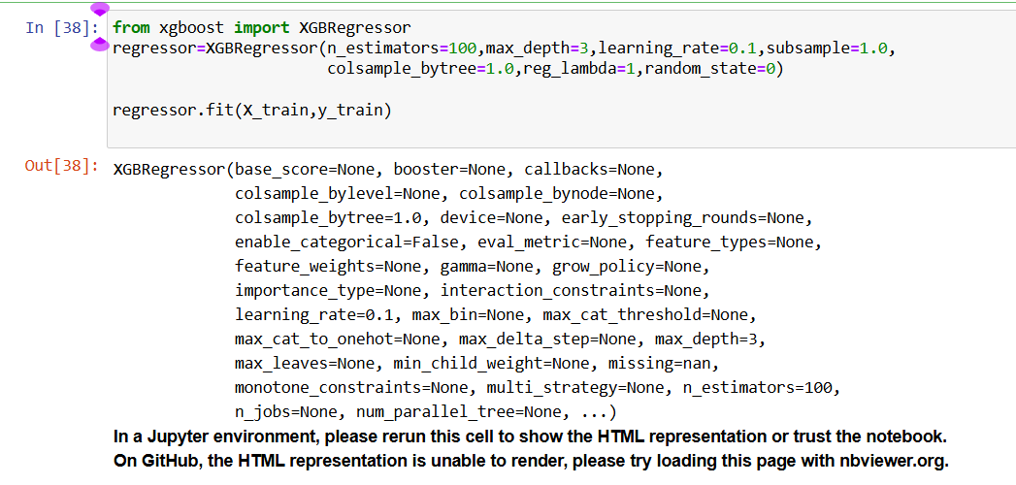
Python Code

Slide 6
How AdaBoost Regression Works
XGBoost (Extreme Gradient Boosting) regression works by sequentially building an ensemble of decision trees, where each new tree is trained specifically to predict and correct the errors (residuals) made by all previous trees combined
Unlike traditional gradient boosting, XGBoost incorporates an advanced mathematical framework that integrates strict regularization directly into the tree-building process to maximize accuracy while preventing overfitting. [1, 2]

Slide 7
Key Features That Make XGBoost Superior
Built-in Regularization: By utilizing λ (L2 regularization) and α (L1 regularization), it keeps leaf weights small and shrinks less important features to ensure excellent generalization
Weighted Quantile Sketch: Instead of scanning every single data point to find optimal split thresholds, XGBoost builds a mathematical histogram distribution to test only the most logical split points, making it incredibly fast on massive datasets
Sparsity-Aware Splitting: If a dataset contains missing values, XGBoost automatically assigns a default direction (left or right branch) for missing data based on which path minimizes loss, eliminating the strict requirement for manual data imputation

